Slide 1
Mindset: Changing the Language

Slide 2
Does this look familiar?
https://youtu.be/UNAMrZr9OWY

Slide 3
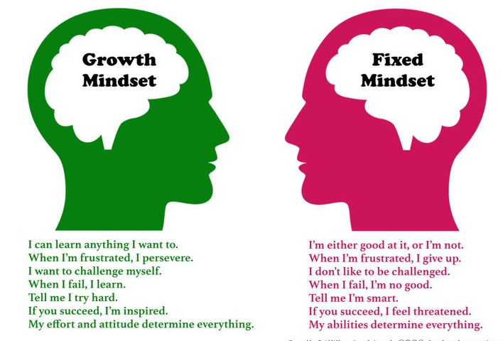
Growth Mindset vs Fixed Mindset

Slide 4
Let’s practice
Read each scenario and decide does this teacher have a fixed or growth mindset?

Slide 5
The most powerful word in the English language
YET

Slide 6
How can we shift our mindset?
By shifting our language
Kid says: I’m not good at this
Teacher response: What are you missing?
Kid says: This is too hard!
Teacher response: This may take some time and effort
Kid says: Plan A didn’t work
Teacher response: Good thing the alphabet has 25 more letters

Slide 7
Expectations
According to John Hattie in Visible Learning for Teachers: The number one influence on student achievement is
Student Expectations
2) RTI
3) Teacher Credibility
4) Formative Assessment

Slide 8
Resources
Visible Learning for Teachers by John Hattie
Mindset by Carol Dweck
Mindsets in the Classroom by Mary Cay Ricci

Slide 9
Conclusion
https://youtu.be/inNMktqIkh0

